Slide 1
Predicting Runs
Nothing But Elastic Nets
Derek Owens-Oas, Federico Ferrari, Fan Bu, Megan Robertson

Slide 2
Defining an “exciting” run
Challenging part of the prompt
Impossible to incorporate every possible situation in the time frame
Determine a reasonable definition
Steph Curry Video
2
2

Slide 3
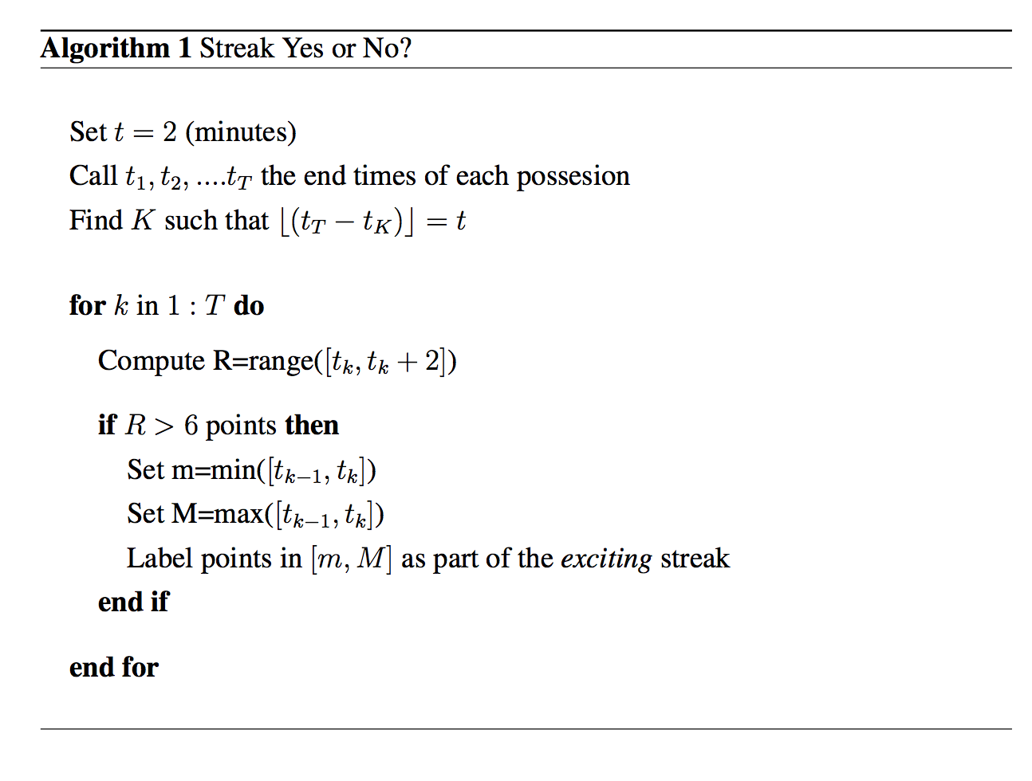
Defining an “exciting” run
ENGLISH
3
3

Slide 4
Feature Generation
Capturing the variability in defining a run
Measuring the pace – number of shots, number of rebounds
Accounting for player skill– how many all stars
Team – not all teams are created equal
4
4

Slide 5
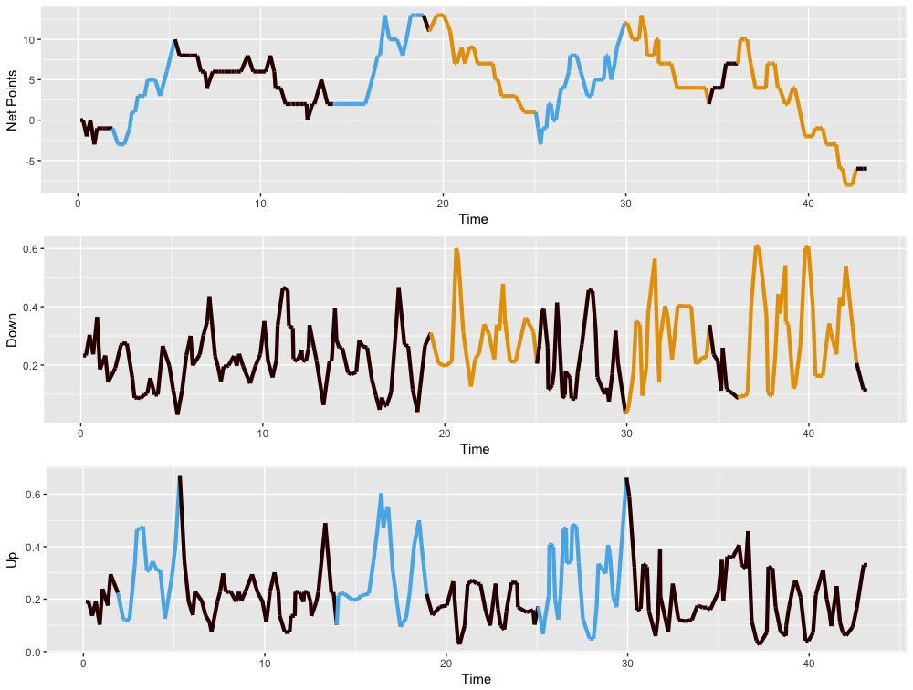
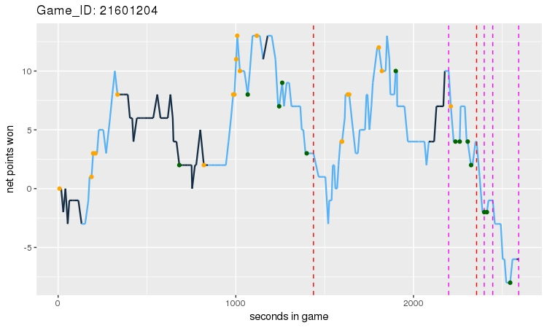
Modeling Run Prediction
Predicting possessions as a classification problem
5
5

Slide 6
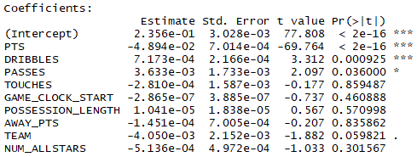
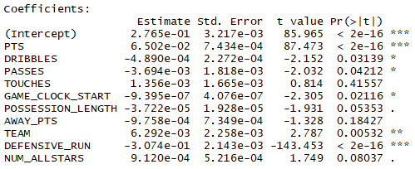
Interpreting coefficients
How did the models perform?
Run Against Model
Run For Model
6
6

